Slide 1
Performance of Sequence vs ArrayList

Slide 2
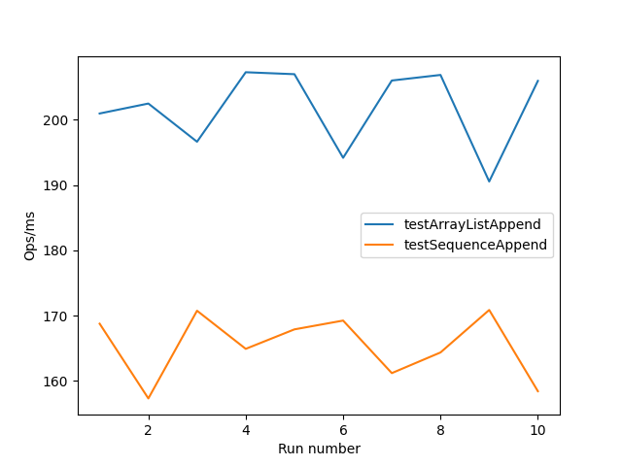
Add vs Append
This is 1000 items being appended to both a sequence and an ArrayList. The Sequence has no information about what is about to be appended, and no parameters have been specified. Speedup may be possible given an initial size of 1000 as no reformatting is needed. Or even possibly a growth factor bigger than 1.5x.
The measurement here is done in two forks and run 10 times. Data plotted is the OPS/ms. The ArrayList has an average difference of 36.406260702470064 compared to the sequence. This means that a full 36 more operations can be carried out per ms on the ArrayList. This equates to 36,000 more add operations can be performed.
This however is much better when we consider keeping items sorted in the array with our next example.

Slide 3
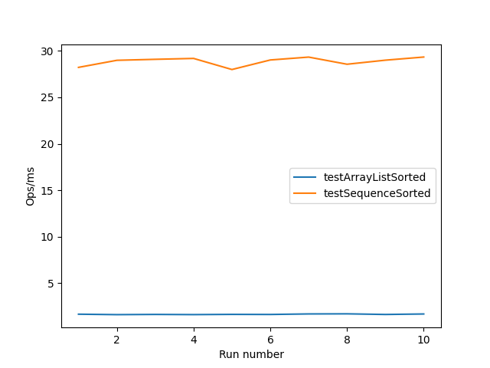
sortOnwards vs Collections.Sort() each time
Here we are appending data to an ArrayList and Sequence in order of the loop (1000 times adding I each time). Then calling sort in order to keep the list sorted. Granted here the Array is already sorted but this calculation would be slower if the data was random. With the sequence we can call the .sortOnwards() function which will allow the list to use insertion order to place the elements. Speeding up checking if the list is in order and simply placing the item where it should be. This could be done with the ArrayList but would require some infrastructure to be setup. Here we don’t need to do anything like that. We can simply just call a method and let the structure do this for us. We are talking about an average difference of 27.233749193648855 of about 27,000 operations on a Sequence of 1000 items being appended in ascending order.

Slide 4
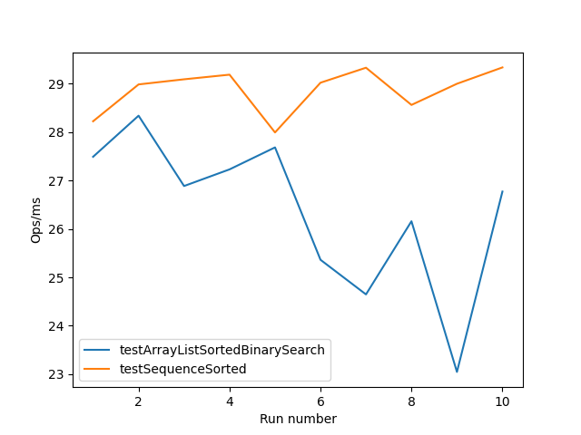
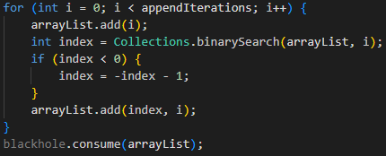

Change to using BinarySearch for insertion
This sees a significant speedup in performance for the arrayList but it does however require much more infrastructure in order to create the same effect. The graph shows the raw data plotted. And below the required code to execute this.

Slide 5
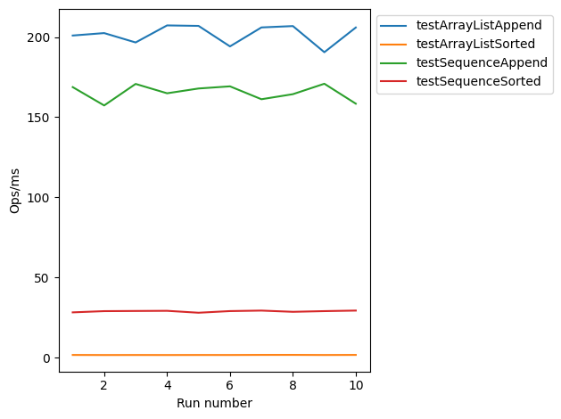
Sorted Non-Sorted Comparison 221224-2330.json

Slide 6
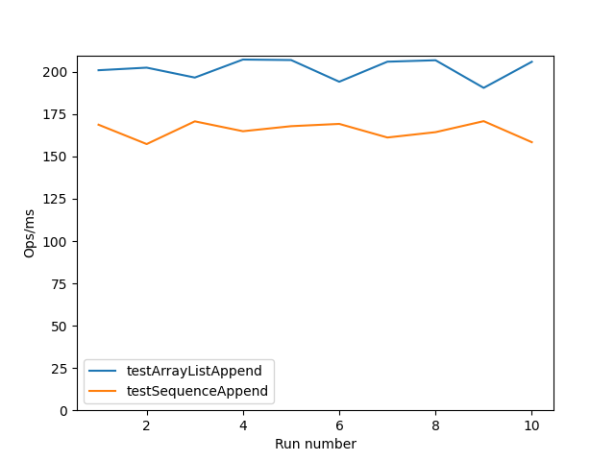
Same as previous page – emphasis on closeness

Slide 7
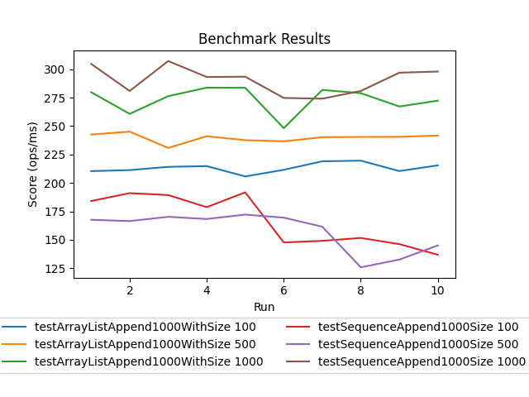
Different initial starting amounts
This shows the performance with some kind of knowledge about what is about to be appended. 100 shows no knowledge. 500 shows that we know it will be at least 500 items but could be more. 1000 shows that we know it will be at most 1000 items appended to the array.

